Slide 2
After this lecture, you will be able to,
learn about Virtual Machine (VM) and its properties
understand the concept of interpretation and binary translation

Slide 3
Virtual Machine (VM)
A software that creates a virtualized environment between the computer platform and the end-user in which the end user can operate software.
Provides an interface identical to the underlying bare hardware.

Slide 4
Virtual Machine (VM)
Virtual machines are “an efficient, isolated duplicate of a real machine”- Popek and Goldberg. Popek and Goldberg introduced conditions for computer architecture to efficiently support system virtualization.

Slide 5
Virtual Machine (VM)
VMs are a number of discrete identical execution environments on a single computer, each of which runs an OS.

Slide 6
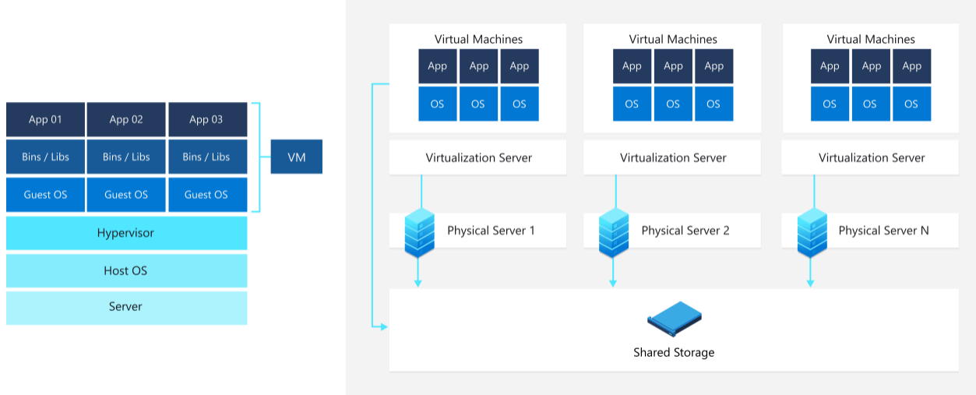
Virtual Machine (VM)

Slide 7
Virtual Machine (VM)
Virtual machines: virtual computers within computers.
VM is no different than any other physical computer like a laptop, smart phone or server.

Slide 8
Virtualization
Virtualization is an abstraction layer that decouples the physical hardware from the OS to deliver greater IT resource utilization and flexibility.
Allows multiple virtual machines, with heterogeneous OSs to run in isolation, side-by-side on the same physical machine.

Slide 9
History of Virtual Machine
Concept of a VM was introduced around 1960.
Evolution of time-sharing technique, where each program has full access to all computer resources but at a time, only one program will be executed.

Slide 10
Virtual Machine Properties
Virtual Hardware

Slide 11
Virtual Machine Properties
Virtual Hardware
Partitioning

Slide 12
Virtual Machine Properties
Virtual Hardware
Partitioning
Isolation

Slide 13
Virtual Machine Properties
Virtual Hardware
Partitioning
Isolation
Identical Environment

Slide 14
Virtual Machine Architecture
Runtime software is the virtualization software that implements the Process VM. It is implemented at the API level of the computer architecture, above the combined layer of OS and hardware. This emulates user-level instructions as well as OS or library calls.
For the system VM, the virtualization software is called Virtual Machine Monitor (VMM).

Slide 15
VM Features
Each VM has its own set of virtual hardware (e.g., RAM, CPU, NIC, etc.) upon which an operating system and applications are loaded.
OS sees a consistent, normalized set of hardware regardless of the actual physical hardware components.

Slide 16
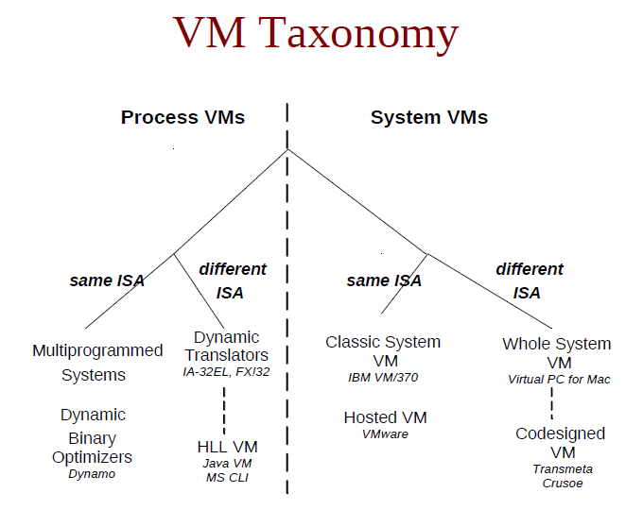
Virtual Machine Taxonomy

Slide 17
Process Virtual Machines
Also known as Application VM.
Virtualization below the API or ABI, providing virtual resources to a single process executed on a machine.
Created for the process alone, destroyed when process finishes.

Slide 18
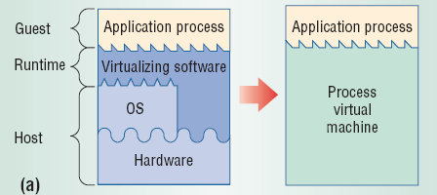
Process Virtual Machines

Slide 19
Process Virtual Machines
Multiprogrammed Systems.
Emulators and Translators.
Optimizers, same ISA.
High-Level-Language VM.

Slide 20
System Virtual Machines
Virtualized hardware below the ISA.
Single host can run multiple isolated Oss.
Servers running different Oss.
Isolation between concurrent systems, security.
Hardware Managed by the VMM.

Slide 21
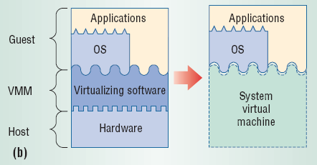
System Virtual Machines

Slide 22
System Virtual Machines
Classically, VMM runs on bare hardware, directly interacting with resources that intercepts and interprets guest OS actions.

Slide 23
System Virtual Machines
Hosted VM.
Whole System VM.
Multiple OSs on one Machine.
Testing of insecure or questionable software and systems.

Slide 24
Uses of Virtual Machines
Building and deploying apps to the cloud.
Trying out a new operating system (OS), including beta releases.
Spinning up a new environment to make it simpler and quicker for developers to run dev-test scenarios.

Slide 25
Uses of Virtual Machines
Backing up your existing OS.
Accessing virus-infected data or running an old application by installing an older OS.
Running software or apps on operating systems that they were not originally intended for.

Slide 26
Benefits of Virtual Machines
Because of their flexibility and portability, virtual machines provide many benefits, such as:
Cost Savings.
Agility and Speed.
Lowered Downtime.
Scalability.

Slide 27
Benefits of Virtual Machines
Because of their flexibility and portability, virtual machines provide many benefits, such as:
Security benefits.
Isolated environment provided by VMs.
Easy to Backup and Clone.

Slide 28
Benefits of Virtual Machines
Faster Server Provisioning.
Beneficial in Disaster Recovery.
Use Older Applications for a Longer Time.
Virtual Machine is Easily Portable.
Better Usage of Hardware Resources.
Made Cloud Computing Possible.

Slide 29
Interpretation and Binary Translation
Emulation- Required for implementing many VMs. It is the process of implementing the interface and functionality of one (sub)system on a (sub)system having a different interface and functionality.
terminal emulators, such as for VT100, xterm, putty.

Slide 30
Emulation
Method for enabling a (sub)system to present the same interface and characteristics as another ways of implementing emulation.
Interpretation
Binary Translation

Slide 31
Interpretation and Binary Translation
Instruction Set Emulation- Binaries in source instruction set can be executed on machine implementing target instruction set. e.g., IA-32 execution layer.

Slide 32
Binary Translation
Intercept OS code: Run-time translation of some OS instructions.
User-level code is directly executed on the real hardware.
No modifications to the OS are needed: the guest OS is not aware of virtualization.
Specific device drivers are required.

Slide 33
Interpretation Vs Translation
Interpretation
Simple and easy to implement, portable.
Low performance.
Threaded interpretation.

Slide 34
Interpretation Vs Translation
Binary Translation
Complex implementation.
High initial translation cost, small execution cost.
Selective compilation.

